Slide 1

Automated Sleep Scoring using Multichannel EEG signal with the Quantitative Assessment of EEG Biomarkers
Prepared by
Md. Abdul Bari, 170042005
Rafsan Jany, 170042044
Musfik Uddin, 170042088
Supervised by
Dr. Md. Azam Hossain
Assistant Professor
Department of CSE
Notes:
Assalamualaikum, our work title is Automated Sleep Scoring using Multichannel EEG signal with the Quantitative assessment of EEG biomarkers. I am Musfik Uddin along with my team members are Abdul Bari and Rafsan Jany. And our supervisor is Dr. Azam Hossain sir.

Slide 2


Motivation
Lack of Sleep causes:
Physical Disorders
High blood pressure
Diabetes
Heart attack
Heart failure or stroke
Mental Disorders
Insomnia
Anxiety
Schizophrenia
10M
deaths due to sleep deprivation [1]
20%
Car accidents due to drowsiness [1]
[1] National Center for Biotechnology information, USA
Notes:
As Sleep is the basic biological need to remove stress, lack of proper sleep can cause many Physical disorder such as high blood pressure, diabetes, heart attack and stroke. Also some mental disorders like insomnia, schizophrenia. A research shows, around 20% car accidents occur due to the drowsiness and around 10 Million deaths due to sleep derivation.

Slide 3
Problem Statement
Automatic Classification of the Sleep Stages using Multichannel EEG signal with the Quantitative Assessment of EEG Biomarkers
Notes:
Though a lot of work has done previously, still there is a lack of reliable automated systems for five-class classification that have acceptable accuracy. That’s why sleep experts often conduct sleep stage scoring manually by visually inspecting the patient’s whole night sleep signals collected at some clinic or labs. This is generally a difficult, and very time-consuming task. For this, our work is to propose a model that can classify five sleep classes more accurately.

Slide 4
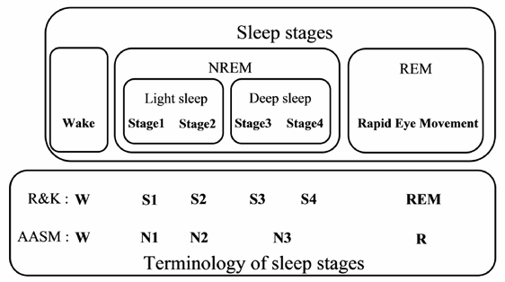
Sleep Stage Scoring
An aggregate of one’s nightly logged sleep data measured on some scale
Helps understand trends in one’s sleep patterns.
Using Polysomnographic (PSG) Signal
Notes:
Now, to understand our work we need to first understand what sleep scoring basically means. sleep score is the aggregate of a patient's nightly logged sleep data with an easy-to-understand metric. Whenever a doctor wants to diagnose a sleep disorder, he first needs to understand the sleep pattern of that patient. Sleep score basically helps to understand the patient's sleep pattern at a glance. Different PSG signals such as EEG, EOG, EMG, ECG can be used for sleep scoring purpose. We are using EEG for our work. And, There are two global standards for sleep stage classification. We are following the AASM standard provided by the American Academy of sleep and medicine for seep classification standard that contains 5 sleep classes.

Slide 5
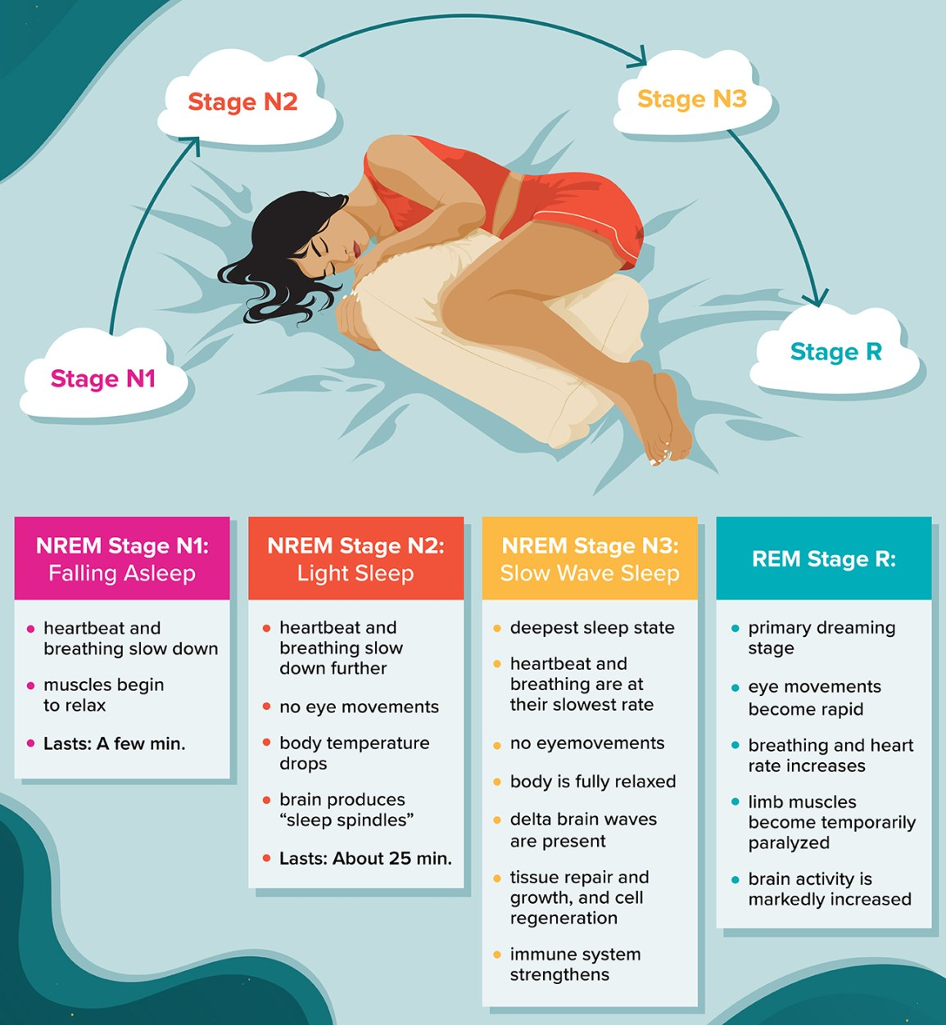
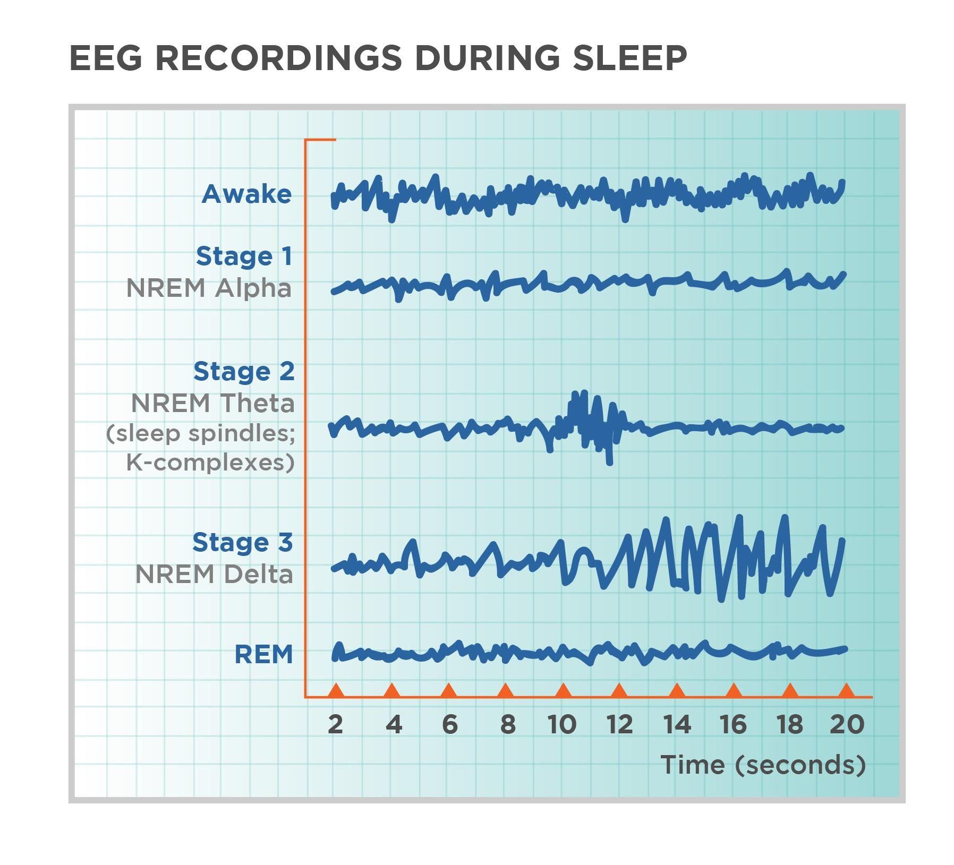
Sleep Stages
Stages of Sleep
According to American Academy of Sleep Medicine (AASM) the state of sleep is split into five sleep stages:
Wakefulness (W)
NREM sleep stage 1 (N1)
NREM sleep stage 2 (N2)
NREM sleep stage 3 (N3)
REM sleep stage (R)
Notes:
The initial stage of human sleep cycle is the non-rapid eye movement stage 1 (or N1 sleep stage, which is the transition between wakefulness stage and drowsiness. This N1 stage starts right after someone falls asleep and lasts very short time. Our Muscles begin to relax in this stage.
The immediate next stage is the N2 stage, where muscles become more relaxed and slow-wave (Theta) brain activity begins in this stage.
The next N3 stage is the beginning of deep sleep and may begin to have delta brain activity. Usually, a person may have little movement in this stage.
Lastly in the rem or rapid eye movement stage, eyes and eyelids flutter generally and breathing becomes more irregular. Most of our dreaming happens during REM sleep.

Slide 6
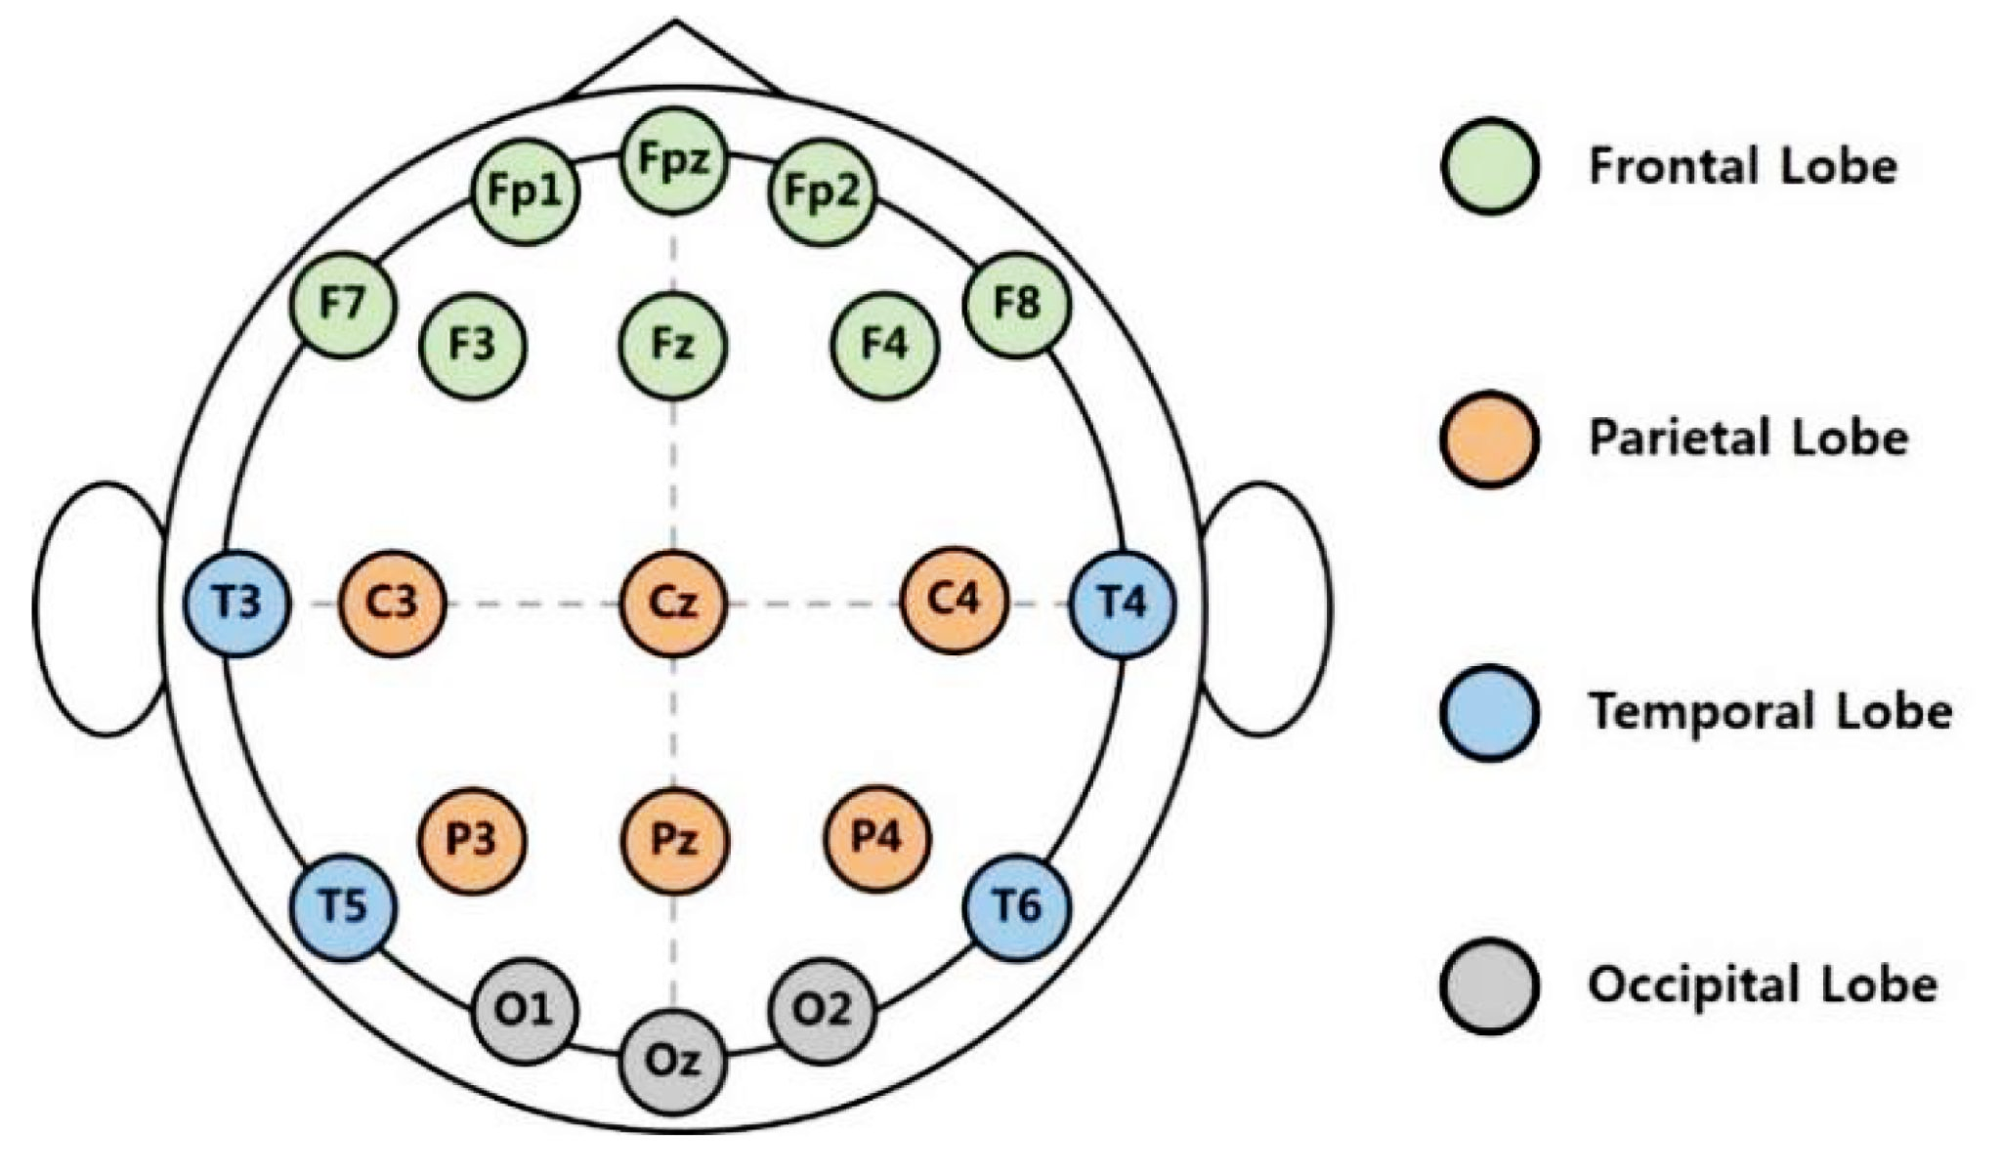
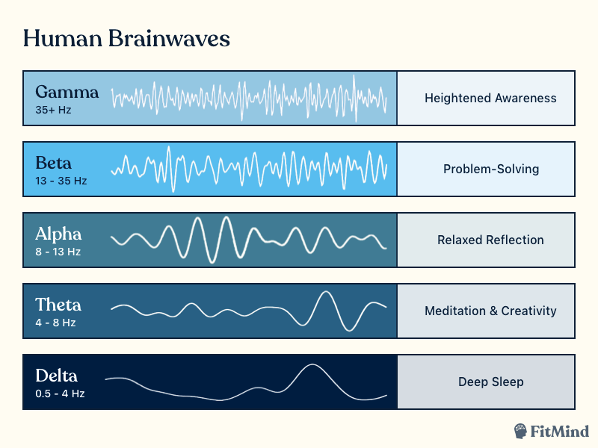
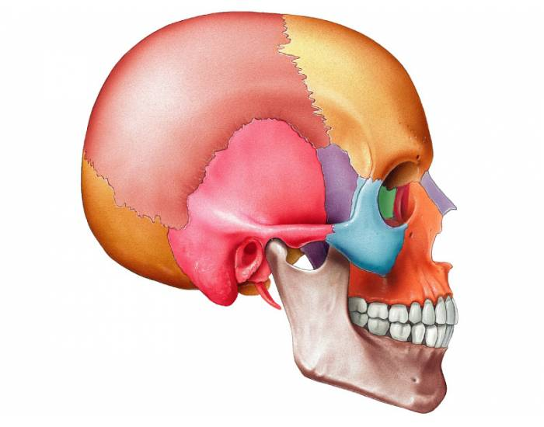

EEG Signal
Brain signals corresponds to various states from scalp.
Parietal
Frontal
Occipital
Temporal
Notes:
EEG or electroencephalographic signals are basically acquired from various location of the scalp covering all lobes. This electrode placements are done by following the global standard 10-20 system, and we are using F4, C4, and 02 channels data, and each channel here is then categorized into alpha, beta, delta, gamma, and theta sub-bands according to the signal frequency range.
These signals are generally categorized as delta, theta, alpha, beta and gamma based on signal frequencies ranges from 0.1 Hz to more than 100 Hz

Slide 7
Literature Review
Study | Year | # of Subjects (channel) | Dataset (Year/ Signal) | Class | Algorithm | Accuracy %
Tzimourta et al.[1] | 2018 | 100 (6-channel) | ISRUC (2009-13/EEG | 5-class [W, N1, N2, SWS and REM] | RF | 75.29
Kalbkhani et al.[2] | 2020 | 25 (4-channel) | Cyclic Alternating Pattern (2001/EEG) | Six-class {W, S1, S2, S3, S4, REM] | Hybrid Classifier | 71.68
Budhraja et al.[3] | 2021 | 1 (5-channel) | Sleep & Cognition Laboratory (2015/EEG) | 5-class [Awake, N1, N2, SWS and REM] | KNN, LR, SVM, MLP, RF, GBDT | 81.25
Satapathy et al.[4] | 2021 | 100 (2-channel) | ISRUC (2009-13/EEG | 2-class [sleep and wake] | SVM, KNN, DT, RF | 93
Notes:
The table here shows a comparative analysis of some studies that are closely related with our research. The 1st and 3rd study used Random forest and GBDT algorithm to classify 5 classes and got accuracy of 75% and 81% respectively. The second study worked on a 6-class classification. They used a hybrid classifier and got 71% accuracy. The 4th study got an accuracy of 93% with RF algo but they worked on 2-class classification only.

Slide 8
Research Challenges
Misclassification among N1, N2 as gamma rhythms are identical
Detecting REM stage
Dataset of N1 is very low
Signal was not perfectly smoothed by FFT
Notes:
We found following research challenges from the literature review.
The first challenge is that sleep stage N1 and N2 are often misclassified. The reason behind this is gamma signal are almost identical in these 2 stages and data of N1 in the dataset is very low as it is the transition period from Wake to N1.
Another challenge is the accuracy of REM sleep is observed low in the most studies.
Also If FFT is used for feature extraction it can not make the signal smooth perfectly.

Slide 9
Key Contribution
Large Dataset
3 EEG channel (C4, F4, O2)
O2 helps detecting REM better
EEG Biomarkers
Analysis with Machine Learning Models
Neural Network
Notes:
Key contributions of our research are -
1.We have used a large dataset containing 154 number of recordings
2.We have used 3 EEG channels C4, F4, O2. with O2 we did able to overcome the challenge of detecting REM better.
3.We have discovered some EEG biomarkers that helped to improve the accuracy. 4.We applied some Machine learning model and developed a Neural Network to classify the sleep stages

Slide 10
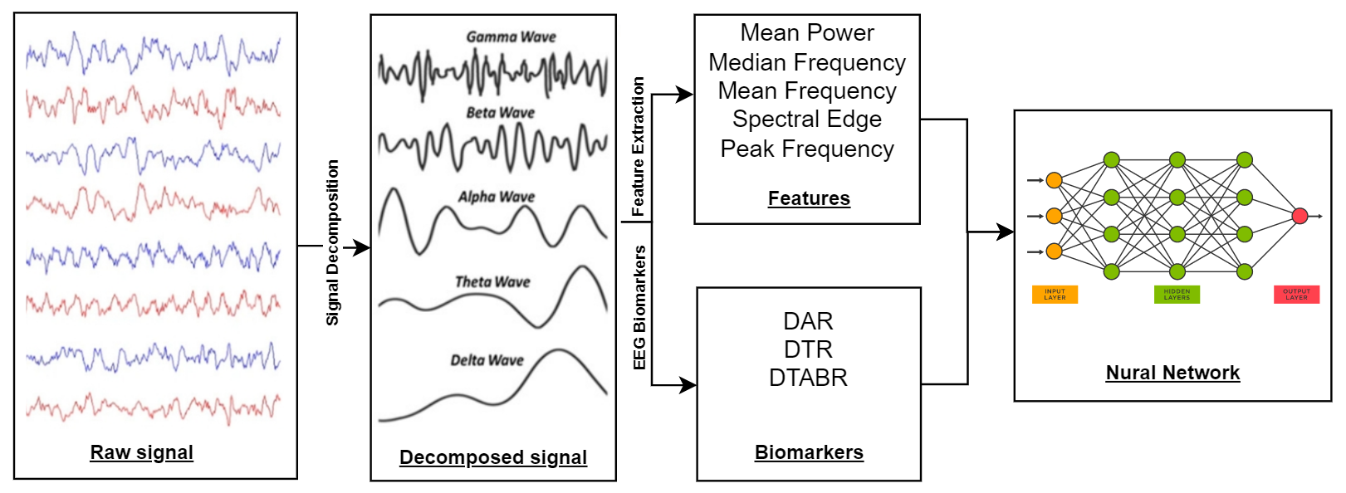
Methodology
Notes:
Now, lets talk about our proposed methodology. At first the raw eeg signal is decomposed into 5 basic signal.

Slide 11
Dataset
Haaglanden Medisch Centrum (HMC) sleep staging database:
Whole-night PSG sleep recording of 154 person (88 Male, 66 Female)
Mean Age of 53.8 ± 15.4
Published on July 1, 2021 (collected during 2018)
Each recording Contains -
A raw signal file ( .edf )
A sleepscoring file (.txt)
Gives sleepscore for an epoch of 30 sec

Slide 12
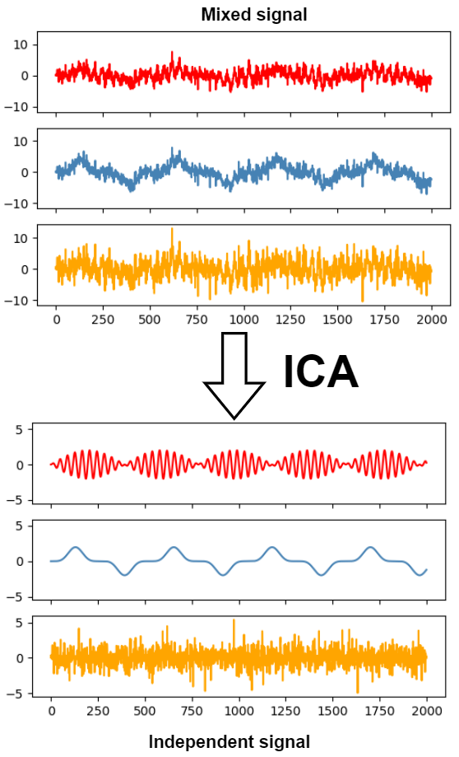
Pre Processing
Infinite Impulse Response (IIR):
Digital filtering to remove 60 Hz AC noise of nearby electrical grid
Independent Component Analysis (ICA):
ICA was used to eliminate EOG and EMG artifacts from the EEG signal
Notes:
While recording the EEG signal some AC noise are captured from the nearby electrical grid. So we applied IIR digital filtering to remove 60 hz AC noise.
Then Independent component analysis was used to remove EOG and EMG artifacts from the EEG signal

Slide 13
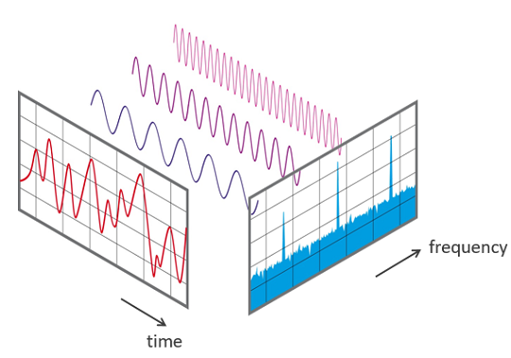
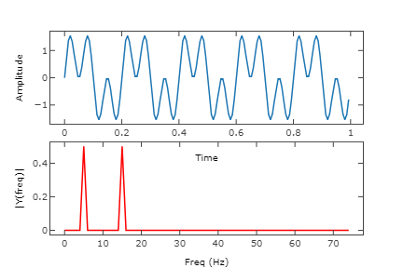
Feature Extraction
Fast Fourier Transform:
Converts the EEG signals from the time domain to a representation in the frequency-domain
BUT the resulting frequency spectrum after applying FFT is likely to be distorted
Notes:
We have used FFT and other techniques to extract the features. FFT converts the EEG signals from the (nonstationarity) time domain to a representation in the (stationarity ) frequency-domain.
BUT the resulting frequency spectrum after applying FFT is likely to be distorted and the reason is that FFT takes the full signal as input at once and perform transformation.

Slide 14
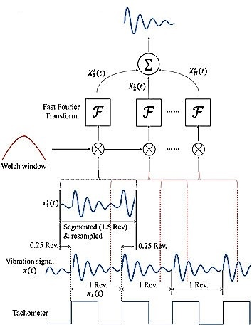
Feature Extraction (cont.)
Welch’s method:
Overcomes the problem of FFT
Separates the data into multiple small window and apply FFT separately for each window.
Notes:
To overcome this problem we applied Welch's method that separates the data into multiple small window and apply FFT separately for each window.

Slide 15
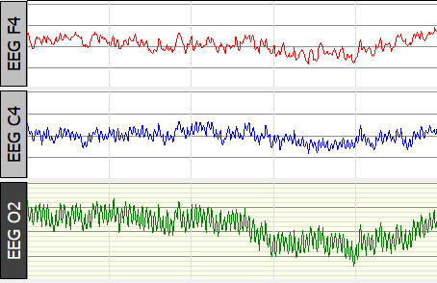
Feature Extraction (cont.)
Power Spectral Density (PSD) method:
To compute numerical statistical measures as followed
Raw Signal
Features from Each (5 type) Signal
Mean Power
Median Frequency
Mean Frequency
Spectral Edge
Peak Frequency
Extracted Data
109006 epoch (row)
75 features (column)
Notes:
Finally Power Spectral Density(PSD) method was used to compute the following measures that are 1.mean power, 2.median frequency, 3.mean frequency, 4.spectral edge and 5.peak frequency.
these measures are the features we are using. we have got a total of 75 features for each epoch of 30 sec data.

Slide 16
EEG Biomarkers
Biomarker is a substance that is measured in a biological system as an indicator of exposure, effect, susceptibility, or clinical disease.
Biomarkers:
DTR = Delta/Theta
DAR= Delta/Alpha
DTABR= (Delta+Theta)/ (Alpha+Beta)
Notes:
Our Bio markers are the predictive Biomarker. a naturally occurring characteristic by which a particular pathological or physiological process, disease, etc. can be identified.
Delta and theta are slow -wave rhythm and Alpha and Beta are fast-wave rythm
DTR= The delta-theta ratio (DTR) was defined as the ratio of delta band power to theta band power
DAR=defined as the ratio of delta to alpha band power,
DTABR=identified as the relative sum of (delta rhythm and theta rhythm) power to (alpha rhythm and beta rhythm) power

Slide 17
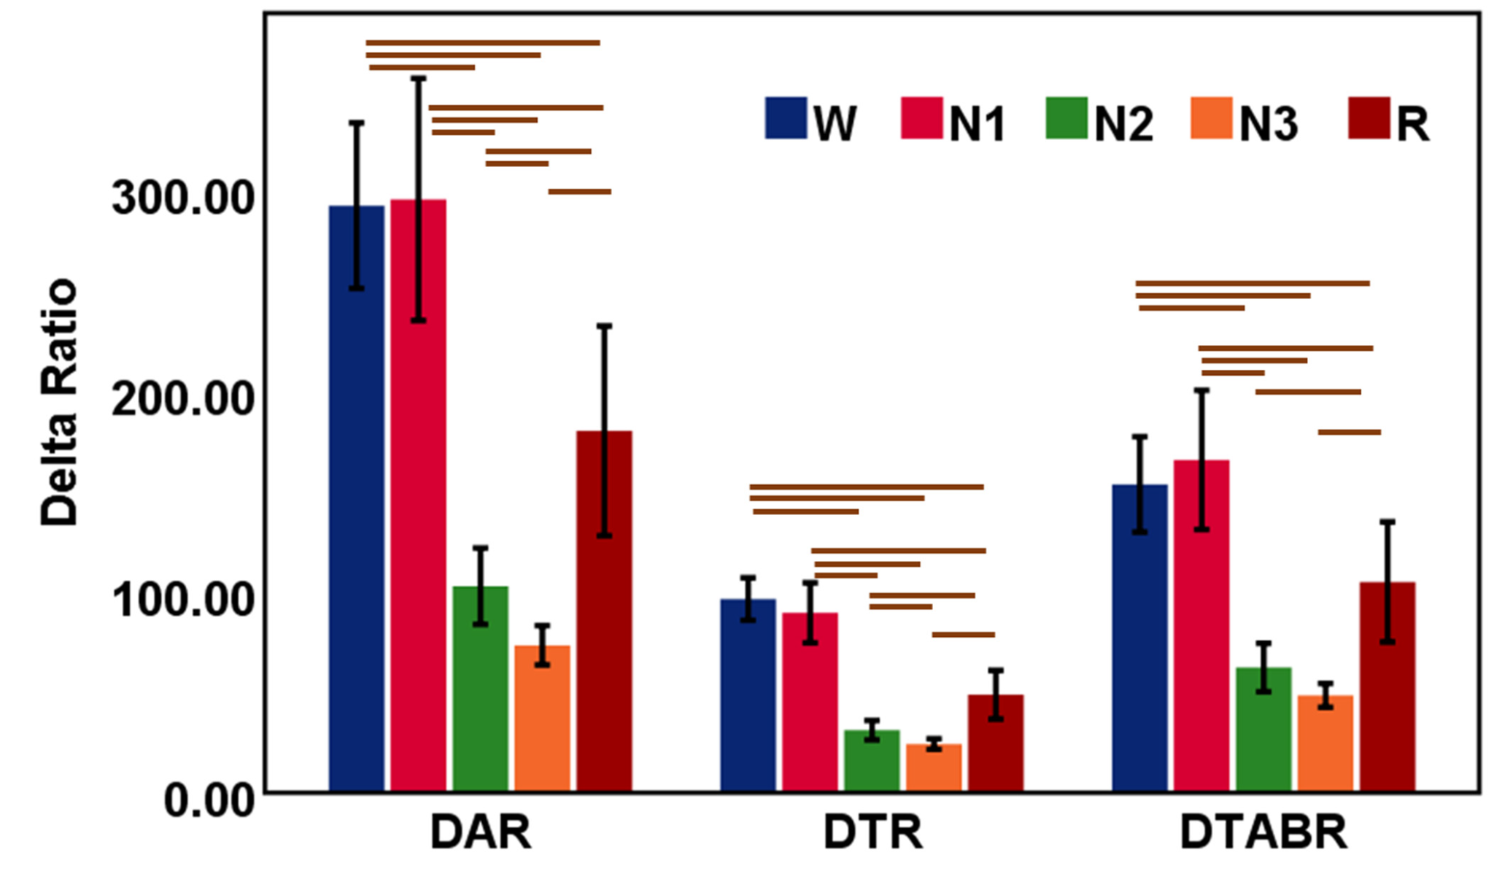
EEG Biomarkers
Characteristics of EEG Biomarkers
DAR, DTR, DTABR dominant in Wake and N1.
Decrease in N2 and N3.
Increase again in REM.
Impact of EEG Biomarkers
Without DAR, DTR, DTAB Best Accuracy 85.06%
With DAR, DTR, DTABR
Best Accuracy 92%

Slide 18
Classification Algorithms
Algorithms | Accuracy
Decision Forest | 76.75%
Support Vector Machine | 70.86%
K-Nearest Neighbour | 75.33%
Extreme Gradient Boost | 72.26%
Neural Network | 92%

Slide 19

Neural Network
Number Of Neurons - 5
Input Neurons Unit - 500
Input Activation Function - Relu
Out Neurons Unit - 75
Output Activation Function- Softmax
Executing Time - 3939 seconds

Slide 20
Result Analysis
Confusion Matrix for Neural Network Without Biomarker
Sleep Stages | Accuracy | Sensitivity | Specificity | Precision
N1 | 0.80 | 0.19 | 0.88 | 0.36
N2 | 0.77 | 0.71 | 0.75 | 0.67
N3 | 0.84 | 0.67 | 0.84 | 0.73
REM | 0.84 | 0.65 | 0.85 | 0.60
W | 0.85 | 0.75 | 0.84 | 0.65

Slide 21
Result Analysis
Confusion Matrix for Neural Network With Biomarker
Sleep Stages | Accuracy | Sensitivity | Specificity | Precision
N1 | 0.89 | 0.23 | 0.97 | 0.46
N2 | 0.80 | 0.78 | 0.82 | 0.71
N3 | 0.91 | 0.74 | 0.95 | 0.79
REM | 0.91 | 0.71 | 0.94 | 0.69
W | 0.92 | 0.86 | 0.94 | 0.75

Slide 22
Result Analysis And Discussion
Sleep Stages | Signal(High) | Signal(Low)
Wake | δ, α, β, γ | θ
N1 (light sleep 1) | θ, γ | δ, α, β
N2 (light sleep 2) | θ, γ | δ, α, β
N3 (deep sleep) | None | δ, θ, α, β, γ
REM (Rapid Eye Movement) | θ, γ | δ, α, β
Delta=δ, Theta=θ, Alpha=α ,
Beta=β, Gamma=γ
Notes:
W = Wake
N1 = Non Rapid Eye Movement 1
N2 = Non Rapid Eye Movement 2
N3 = Non Rapid Eye Movement 3
REM= Rapid Eye Movement

Slide 23
Future Work
Extend with multimodal signals (EOG & EMG) to enhance the accuracy of the prediction model.
Investigate the explainability of prediction models.

Slide 24
References
[1] Giannakeas, N.; Tzimourta, K.D.; Tsilimbaris, A.; Tzioukalia, K.; Tzallas, A.T.; Tsipouras, M.G.; Astrakas, L.G. EEG-Based Automatic Sleep Stage Classification. Biomed. J. Sci. Tech. Res. 2018, 1, 6.
[2] Tripathy, R.K.; Ghosh, S.K.; Gajbhiye, P.; Acharya, U.R. Development of Automated Sleep Stage Classification System Using Multivariate Projection-Based Fixed Boundary Empirical Wavelet Transform and Entropy Features Extracted from Multichannel EEG Signals. Entropy 2020, 22, 1141.
[3] Budhraja, S., Bhattacharya, B. S., Durrant, S., Doborjeh, Z., Doborjeh, M., & Kasabov, N. (2020, July). Sleep Stage Classification using NeuCube on SpiNNaker: a Preliminary Study. In 2020 International Joint Conference on Neural Networks (IJCNN) (pp. 1-8). IEEE.
[4] Satapathy, S. K., & Loganathan, D. (2021). A Study of Human Sleep Stage Classification Based on Dual Channels of EEG Signal Using Machine Learning Techniques. SN Computer Science, 2(3), 1-16.

Slide 25
THANK YOU
Any feedback is appreciated

